Slide 1
Methamphetamine:
What’s old is new again
Sheri L. Fandrey, BSP, PhD
Knowledge Exchange Lead

Slide 2
Agenda
What are amphetamines & methamphetamine?
How common is methamphetamine use?
How does methamphetamine affect users?
Why does the method of use matter?
Who is at higher risk from meth use?
What do meth users look like?
What are the short- and long-term effects?
How can we deal with someone who is using?
Does anyone recover from meth addiction?

Slide 3
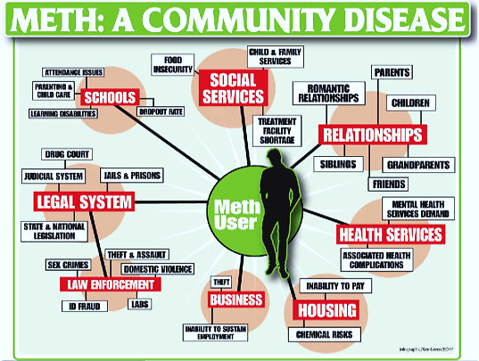

Slide 4
What’s the attraction?
Stimulants have a long history of recreational use
The pleasurable sensations include:
  enhanced energy
  alertness
  talkativeness
  well-being/euphoria
Stimulants are well accepted by our society
  Caffeine, nicotine
Therapeutic uses
  Obesity (??), narcolepsy, nasal congestion, ADHD

Slide 5
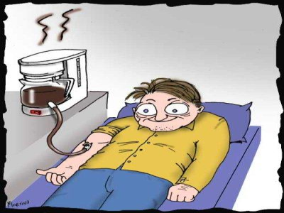

Slide 6
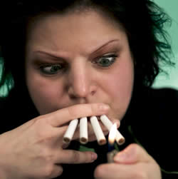

Slide 7
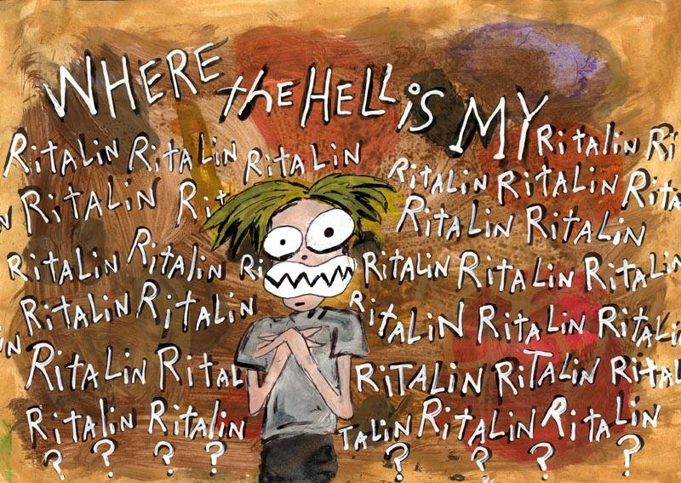

Slide 8
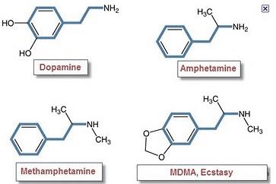
Relationship to Amphetamine

Slide 9
What is methamphetamine?
The powdered form is commonly referred to as speed, crank, or chalk.
Can be pressed into tablets, chunks or sold as capsules.
The crystalline form is known as crystal, ice, tina or bitch.

Slide 10
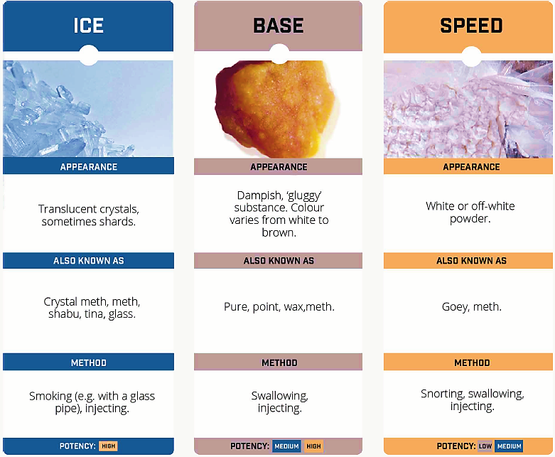

Slide 11

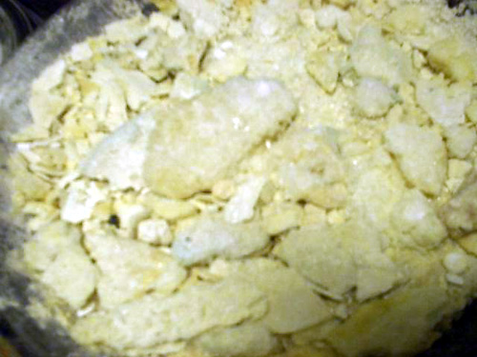
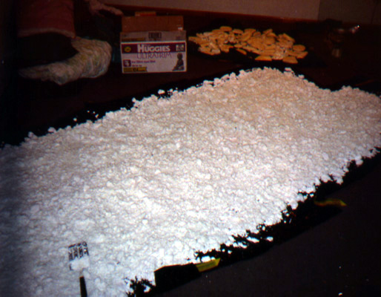
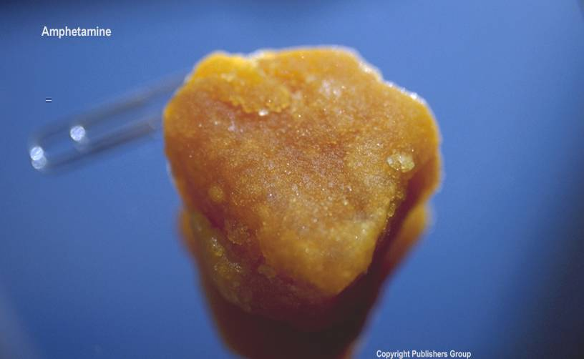
What does meth look like?
Notes:
The powdered form is commonly referred to as speed, crank, or chalk.
Can be pressed into tablets, chunks, or sold as capsules.
The crystalline form is known as crystal, ice, tina or bitch.
Odorless, bitter tasting powder.
Powder ranges in color from white, yellow, orange, pink or brown.
Color variations are due to differences in chemicals used to produce it and the expertise of the cooker.

Slide 12
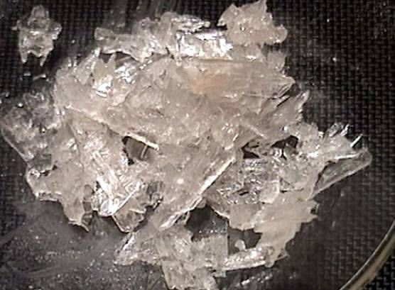
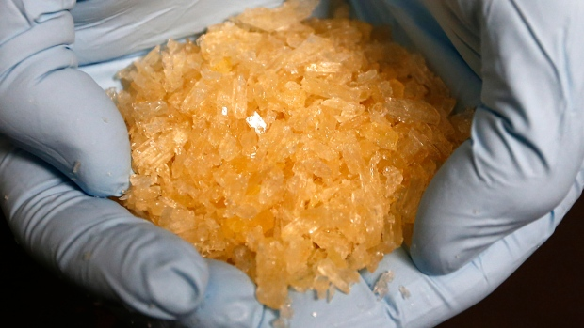
What about crystal meth?
Notes:
Crystal meth
An extremely pure, smokeable, form of meth.
Appears as broken shards of glass, or crushed ice translucent to white, or with a coloured tinge.
Smoked in a glass pipe, light bulb, or in tin foil without direct flame – residue can be resmoked.

Slide 13
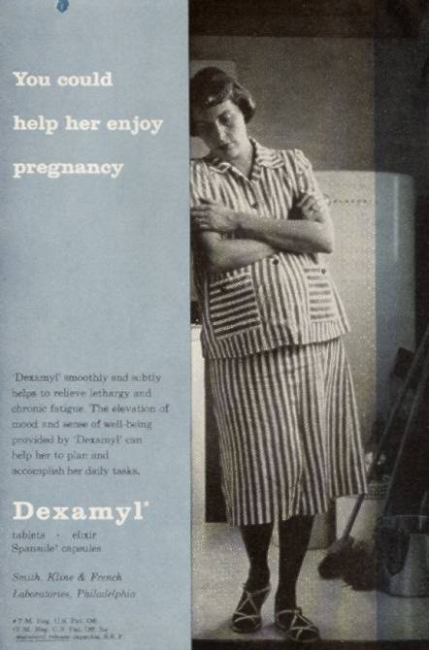
What’s old is new again…
Notes:
1887 Amphetamine developed in Germany
1919 – Methamphetamine first synthesized by Japanese chemist
1930’s Amphetamine was first marketed as “Benzedrine” an OTC inhaler to treat asthma
Amphetamine available by prescription for treatment of narcolepsy and ADHD
WW II – Used to combat fatigue and to suppress fear by all sides during the war
Extensive use by : RAF Pilots, German Weirmacht, Russian Red Army, and Japanese Kamikaze pilots
Rampant abuse in Japan and Sweden
1950’s – Legally manufactured tablets of both Dexedrine and Methedrine became readily available.
Used non medically by college students, housewives, truck drivers, and athletes.
Became a cure-all for weight control, staying awake and mild depression.
1959 - over the counter inhalers removed from distribution
1960’s -”speed” played a prominent role in an era known for drug experimentation and “free love.” The Beatles in Hamburg.
Controlled Substances Act of 1970 drastically reduces availability
In response to dwindling supply of tightly regulated legal prescriptions, people bought black market “crank” that had been marketed illegally.”
’80s & ’90s - Clever street chemists learn to alter commonly available compounds to produce a highly potent and smokeable form.
Surprisingly, because of it’s intensity, “ice” did not catch on in the U.S. as a common drug of abuse except in Hawaii and parts of the West Coast.
During the Canadian/American “friendly fire” incident, prescribed amphetamine use was a factor.
U.S. Air Force Pilots flying from Colorado to Afghanistan (a 26h round trip) – Pilots are medicated to keep them alert.
Part of the defense included that pilots had never used “speed” before.

Slide 14
Why is meth so special?
Methamphetamine use is still a concern
  Recently, use has risen sharply in Manitoba
  Does not respect urban and rural boundaries
  Abuse is not restricted to disadvantaged groups
  Cost – recently the cost of meth has been greatly reduced (from ~$30/0.1g  $5-10/0.1g)
  Large population of people using   crime rates
  Users can be very unpredictable, depending on:
    How the drug is administered (e.g., smoked vs. IV)
    Amount & duration of use
    Polydrug use

Slide 15
The Power of Meth
“It delivers an intensity of pleasure completely outside the normal range of human experience. It offers the most wonderful state of consciousness and the most intense sense of being alive, the user will ever enjoy.”
-Anonymous

Slide 16

Use
&
Users

Slide 17
How many people use meth?
Overall, methamphetamine use is quite low.
Past year use ranges from 0.2-1%:
  Canadians aged 15+ - 0.2% (CTADS 2015)
  Manitoba students (gr 7-12) – 1% (MYHS 2012-13)
AFM clients (youth & adult)
  past year use almost doubled from 2014-15 to 2016-17
  females more likely to report use
Anecdotal reports
  There appears to be an increase in use of meth in some sub-populations (i.e., high risk/vulnerable, street involved)
  These reports indicate IV injection is now the preferred route
  Increased use often linked to scarcity of cocaine in a community/region

Slide 20

How is meth used?
Smoked
Injected
Snorted
Ingested
Notes:
World-wide
60-70% smoked
10-15% snorted
10-15% injected
United States
52% snorted
21% injected
18% smoked

Slide 21
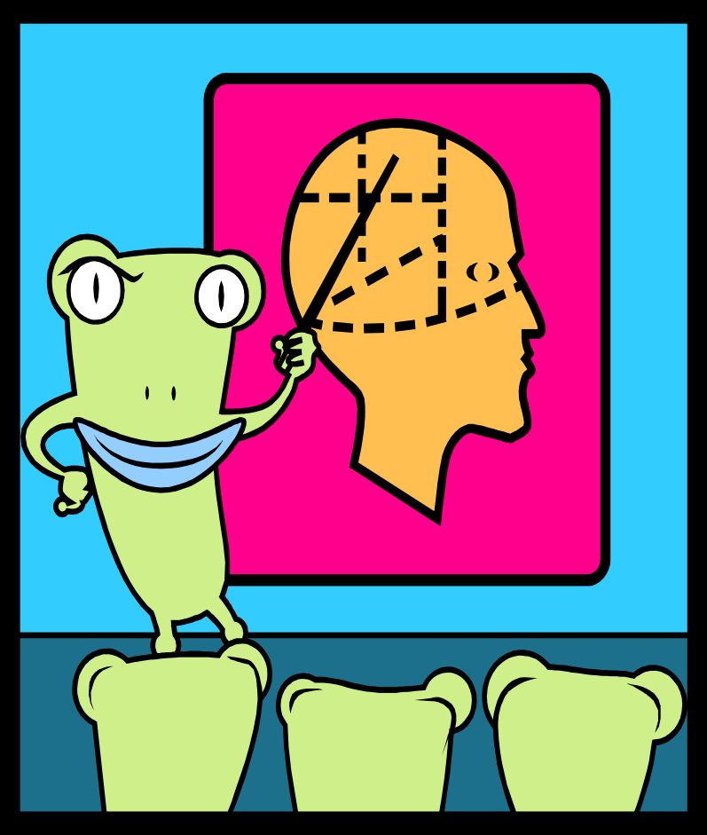
Efficiency of delivery
Ingesting
  15-30 minutes
Snorting
  3-5 minutes
Injecting
  15-30 seconds
Smoking
  5-10 seconds

Slide 22
Meth abuse patterns
Low intensity abuse
  casual user
  not psychologically addicted
  may be used to control weight
  MOST common user
Binge abuse
High Intensity
  “speed freaks”

Slide 23
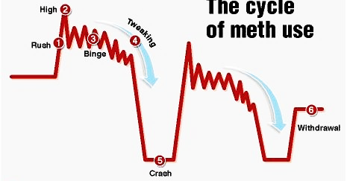
Cycles of methamphetamine use
High intensity use
Notes:
Rush – 5-30 min
Feeling of pleasure & euphoria
 metabolism, BP & HR
High – 5-15 h
False sense of confidence & power
User finishes other people sentences
Becomes argumentative
Binge – 3-15 days
User becomes hyperactive mentally & physically
Avoids sleep for days
User becomes paranoid & delusional
Tweaking – 4-24 days
No amount of meth will bring back the high the user craves
User is irritable and paranoid from not sleeping for days
User often behaves or reacts violently & is very dangerous to self & others
User often takes a depressant (e.g., alcohol or opioids) to ease the bad feelings
Crash – 1-3 days
User needs an incredible amount of sleep
The body’s adrenaline has been depleted and the crash helps to replenish supply
The meth crash is more intense & longer-lasting than those of speed and cocaine
In each successive cycle, the highs are not as high
Withdrawal – 2-3 weeks, up to 6-8 weeks
After a person stops taking meth, withdrawal can last more than a month
The user becomes depressed, confused and restless
User has insomnia and sever craving
May be suicidal
Taking meth can stop the unpleasant feelings – high rate of return to use

Slide 24
Indicators of meth use
Irritability
Anxiety & nervousness
Lack of focus
Fast/continuous speech
Constant change of subject in conversation
Incessant movement by the user
Profuse sweating
Aggressive/violent behaviour
Small sores on the arms & face – similar to chicken pox

Slide 25
Groups at higher risk
Rural areas
Students/ Adolescents
Low income
Women
MSM
Disenfranchised
  homeless
  club scene
  co-occurring disorders
  youth in care (CFS)

Slide 26

Effects of
Meth

Slide 27
How does meth work in the brain?
Noradrenaline
Serotonin
Anxiety
Impulse
Irritability
Alertness
Concentration
Energy
Obsession
Compulsion
Memory
Mood
Cognitive
function
Appetite
Aggression
Sex
Attention
Dopamine
Reward
Pleasure
Motivation/Drive
Notes:
Indirect-acting sympathomimetic
blocks presynaptic release and reuptake of catecholamines (dopamine, norepinephrine, serotonin)
excess of neurotransmitters at synapses
Dopamine: change in mood, excitation, motor movement, feelings of pleasure
Norepinephrine: sympathomimetic effects (panic/anxiety)
Serotonin: mood changes, aggressiveness, psychotic behaviour

Slide 28
Dopamine & Reward
Notes:
This is dopamine in your brain! Natural rewards elevate dopamine.
Amounts are percent increases over baseline amount values are (50, 100, 150, 250, 300 1100% respectively)
Higher rush associated with stronger cravings
Smoking & shooting meth gives very big rush in 5-7 seconds.
Less of a rush from ingesting or snorting meth

Slide 29
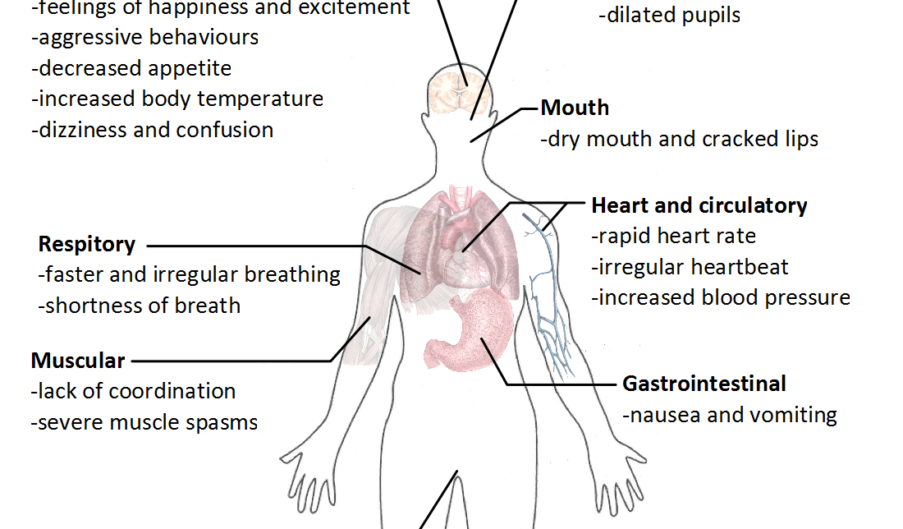
Immediate effects
Notes:
Increased attention & decreased fatigue
Unbridled energy
Reduced need for sleep
Increased activity
Reduced appetite
Euphoria & rush
Talkativeness/ Pressured speech
Increased confidence
Increased sex drive
Increased respiration
Hyperthermia

Slide 30
Dose-related effects
Low-moderate
Euphoria, “rush”
Alertness/wakeful
Increased confidence
Hyperactivity
Loss of appetite
Higher doses
Talkativeness
Aggression
Restlessness
Repetitive behaviour
Very high/bingeing
Agitation, confusion, panic
Anxiety, irritability
Negative mood
Violent behaviour
Impaired motor skills
Impaired thinking
Persistent repetition of meaningless behaviours
Auditory hallucinations
Feeling of insects under skin
Paranoia

Slide 31
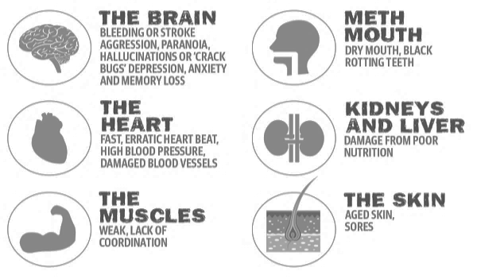
Long-term effects

Slide 32
The Brain
Neurologic Issues
Headache
Seizures
Stroke
Bleeding in the brain
Insomnia
Speech & thought disturbances
Memory loss
Overheating
Psychiatric Issues
Addiction & dependence
Tolerance & withdrawal
Panic reactions
Depression/anhedonia
Psychosis
  Paranoia
  Hallucinations
  Mood disturbances
  Repetitive motor activity

Slide 33
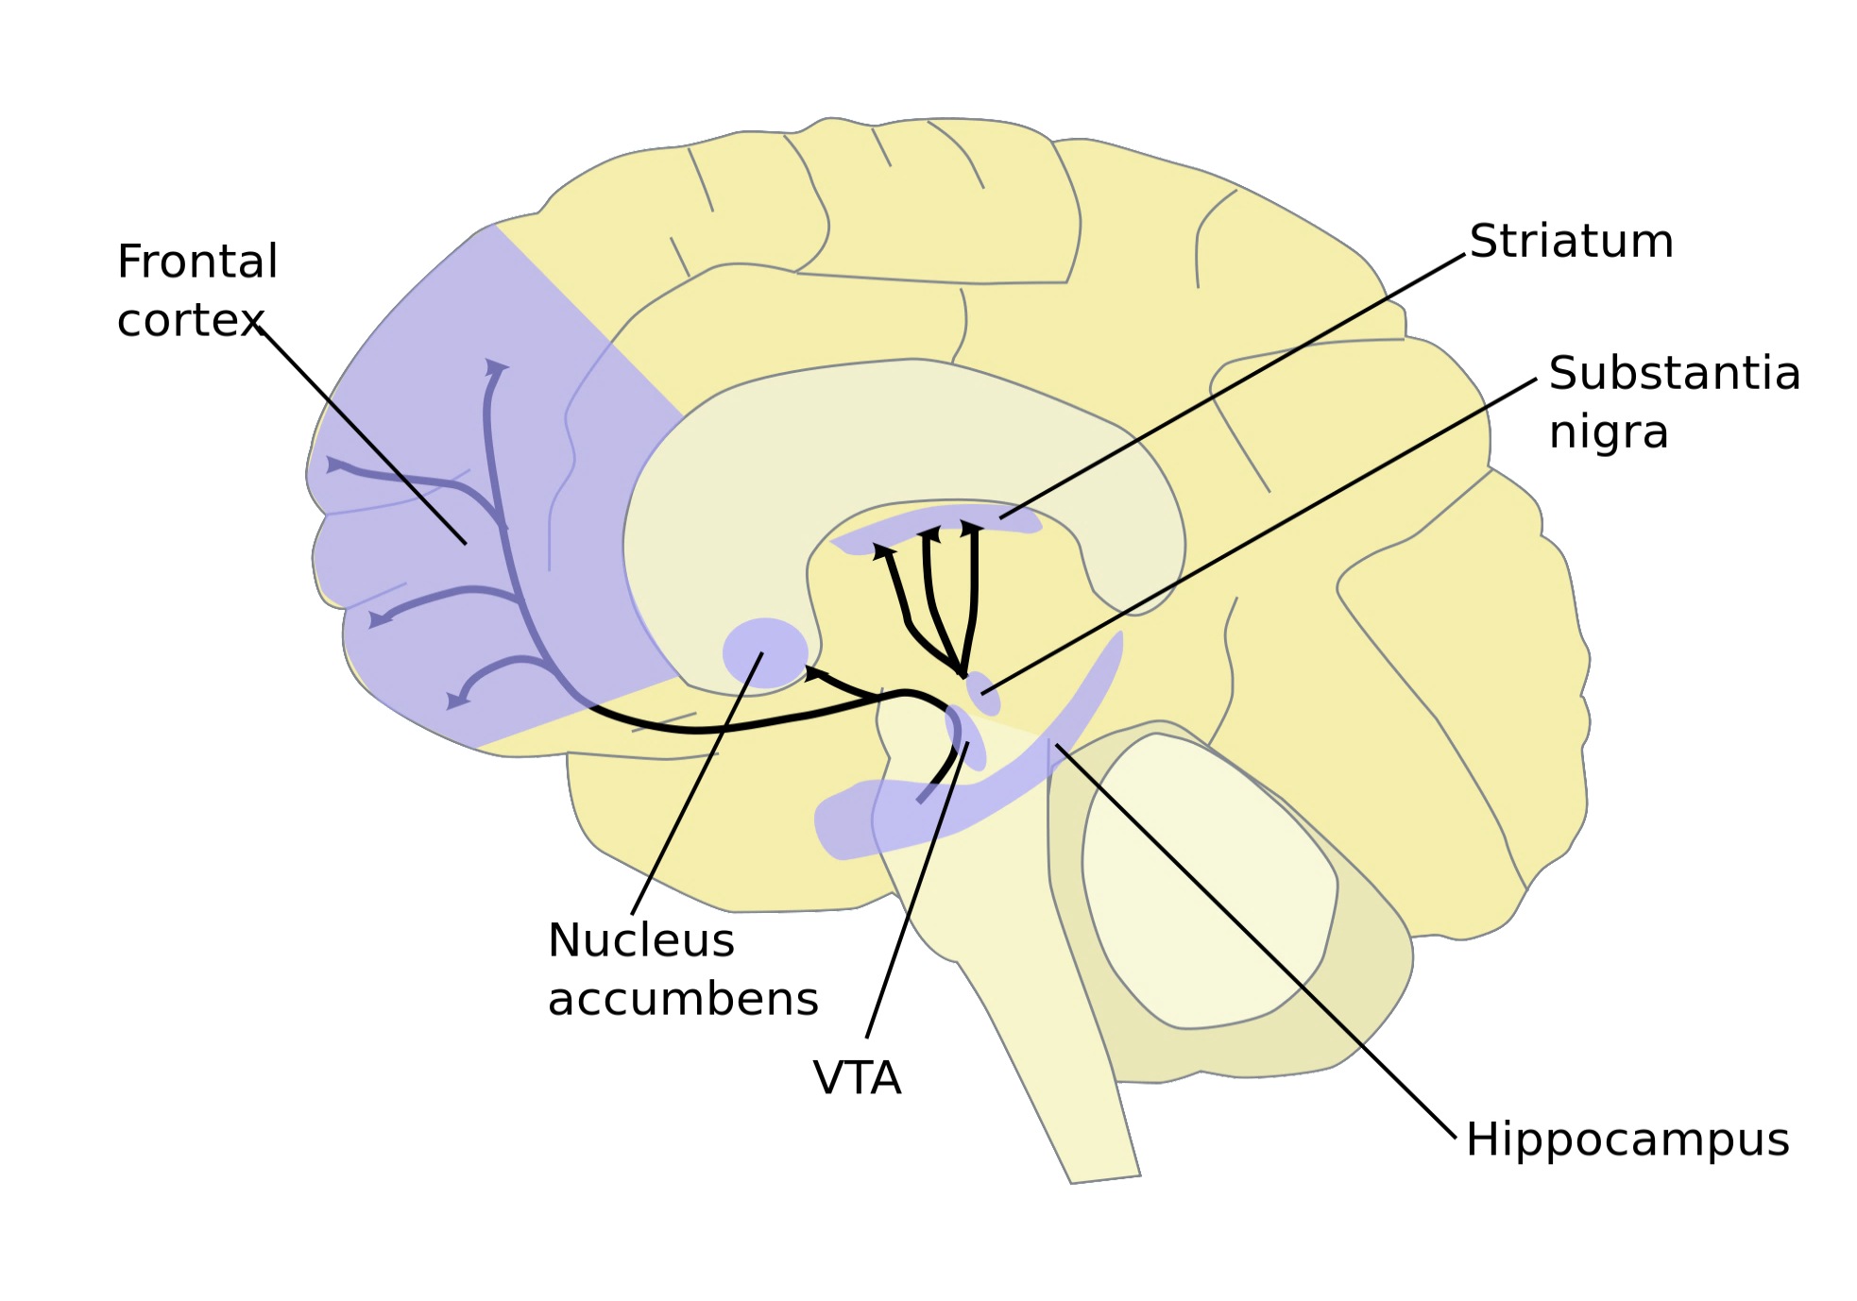
Cell death & damage to nerve terminals
Cell death
Cell death

Slide 34
Permanent brain damage?
Short-term use associated with loss of dopamine receptors and transporters
  also reported in alcoholics, cocaine & heroin addicts
Higher doses/longer use results in damage to nerve axons
Some improvement after 12-18 months abstinence
  still some difficulties with reduced motor speed and impaired verbal learning
Nothing like Korsakoff’s syndrome is seen with methamphetamine users

Slide 35
Meth & Psychosis
Meth users are much more likely to experience psychosis than the general public
After psychotic episode, further episodes are more likely
Almost 25% of regular meth users will have psychotic symptoms in a year
Key risk factors:
  Intensity of use (high doses for long periods of time)
  Dependence on meth
  History of schizophrenia
  Cognitive impairment
  Childhood trauma ( adverse childhood events)
About 1/3 of people with meth-induced psychosis go on to develop primary psychosis
Notes:
High use of methamphetamine seems to be a greater risk factor for psychosis among those with more adverse childhood experiences
Cognitive impairment is both a risk factor for amphetamine-induced psychosis and a possible consequence both of use and of psychosis
Cognitive impairment may follow the use of amphetamines, and seem to precede psychosis in users, suggesting cognitive impairment as a possible mediator between use of amphetamines and psychosis.
About one-third of the patients diagnosed with amphetamine-induced psychosis over time ended up with a diagnosis of primary psychosis, indicating that there is a substantial transition in diagnosis over time.

Slide 36
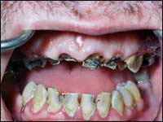
Meth Mouth
Reduced blood flow
Dry mouth from less saliva
Bruxism/grinding
Craving for sweets
Disregard for oral hygiene

Slide 37
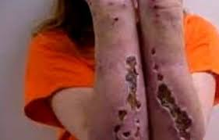
“Speed bumps / Crank bugs”
Notes:
Formication
Absence of sebum
Hyperpyrexia
Presence of toxic substances

Slide 38
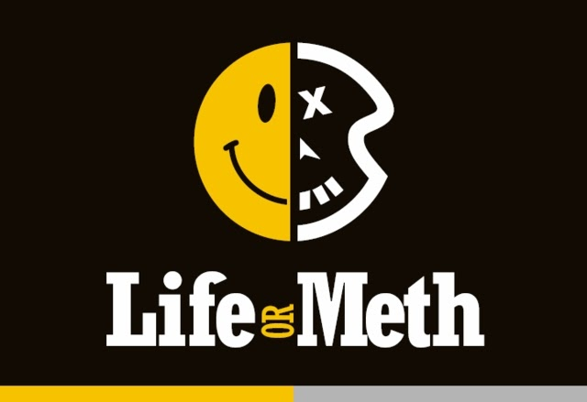
Effects of
Meth

Slide 39





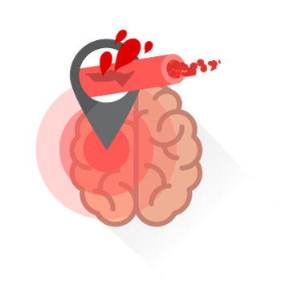



Rapid HR
Arrhythmia
Signs & Symptoms of Overdose
Rapid
breathing
High fever
High BP
Seizures
Stroke
Coma
Death

Slide 40
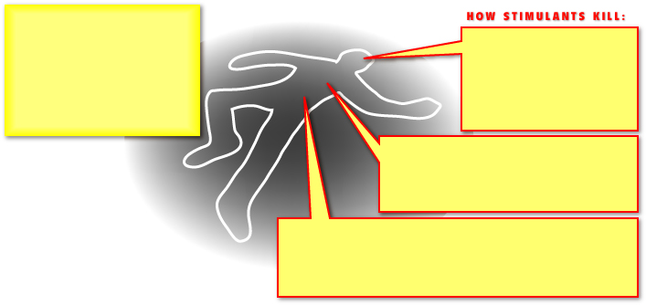
Stimulants such as cocaine and methamphetamine trigger the release of the norepinephrine, which causes:
- Increased motor activity
- Increased heart rate
- Increased blood pressure
- Narrowing of blood vessels
1. Brain damage
Increased blood pressure increases the risk of a ruptured blood vessel in the brain. Narrowing of blood vessels reduces blood flow around the brain.
2. Heart attack
Increased oxygen demand by the heart (because of increased motor activity) accompanied by reduced blood supply (narrowing of blood vessels) can lead to heart attack.
3. Overheating
One function of dopamine is to regulate body temperature. Altering DA levels with stimulants can affect the body's ability to cool itself. Combined with increased motor activity, this can lead to a dangerous hyperthermia, resulting in organ failure and death.

Slide 41
*Figures for 2017 includes data up to Oct. 3

Slide 42
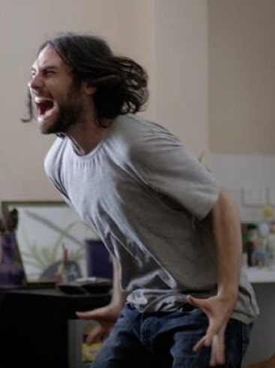
Challenging Behaviours

Slide 43
Aggressive behaviour
Methamphetamine is a potent stimulant – it tends to produce anxiety & aggressiveness
  Paranoia can contribute to this behaviour
The level of aggression depends on dose
Setting is also important – a highly stimulating environment may exacerbate aggression
Pre-existing susceptibility to violence is also an important contributor to behaviour (e.g., lack of impulse control)
Misinterpretation of others’ actions may lead to inappropriate aggressive responses

Slide 44
Dealing with intoxication
Recognize the signs/symptoms
Do not confront
Be aware of what’s going on for you
  Control your own behavior
  Be aware of personal space
Reduce stimuli
Encourage the person to relax
Use person’s name & repetition (broken record)
Look for areas of agreement
Don’t be afraid to ask for help

Slide 45
Meth Withdrawal
Severity of withdrawal from methamphetamine depends on the duration & amount of meth use
Symptoms may include:
  Fatigue/excessive sleeping – may begin with a long crash (up to 3 days)
  Apathy
  Depression & suicidal ideation
  Anxiety & agitation
  Paranoia
  Aggression
  Intense craving for the drug
Symptoms may last for days with occasional use & weeks/months with chronic use

Slide 46
Withdrawal Management
Care Tips
Observation and Monitoring
Medication
Rehydrate body
Quiet and calm environment
Sleep and rest in bed as needed
Individualized daily routine and structure
Offer accurate, realistic information about drugs and withdrawal symptoms
Help to alleviate anxiety and fears
Notes:
1. Observation and monitoring:
Monitor client mental state and observe for complications such as psychosis, depression, anxiety and severe agitation. Patients who exhibit severe psychiatric symptoms or if the progression of moderate symptoms indicate the potential to become severe, require a transfer to the Brandon Regional Health Centre for appropriate assessment and treatment.
2. Medication:
The mainstay of treatment for stimulant withdrawal is based on symptoms.
Analgesics for muscle aches/pains, anti-nausea & antidiarrheal to treat flu-like symptoms associated with stimulant withdrawal.
3. Stimulants suppress appetite and increase body activity resulting in a common condition of dehydration. A concentrated effort to rehydrate the body will help the client feel better.
Encourage client to drink at least 2-3 liters of water per day during stimulant withdrawal.
Recommend client create incentives to drink more water such as use of lemon, cucumber to change the taste or try flavored vitamin water.
Suggest other means of ingested fluid, including soups, broths, juices, and foods high in water (i.e. watermelon).
Suggest client avoid caffeinated beverages because they increase fluid loss
4. There is no evidence that physical exercise is helpful for stimulant WM. Physical exercise may prolong withdrawal and make withdrawal symptoms worse. [This is not to be confused with Physical exercise being beneficial for a client experiencing Post-Acute Withdrawal (PAW) vs. Acute Withdrawal symptoms]
Physical exercise as tolerated only.

Slide 47
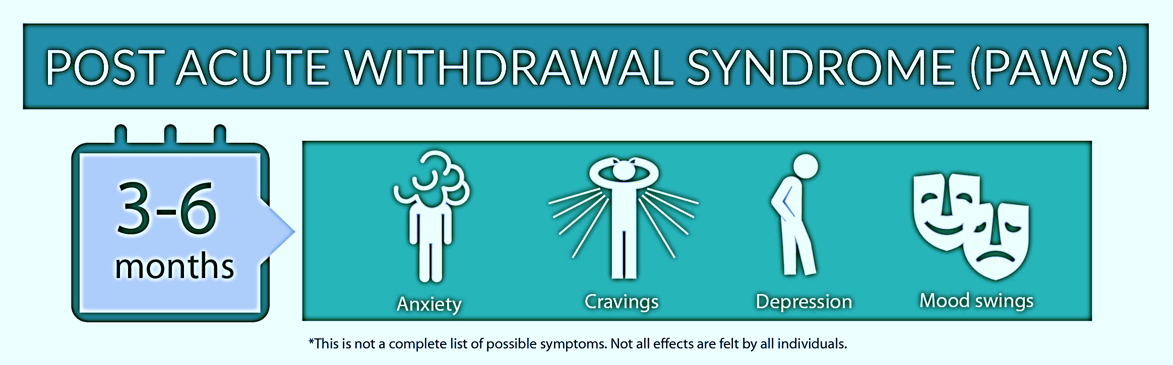

Slide 48

Roadmap for Recovery

Slide 49
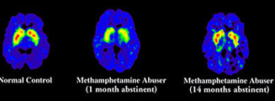
Brain recovery
Notes:
Brain Recovery in Meth Abusers
Long-term methamphetamine abusers who abstain from the drug for more than a year show signs of structural and functional recovery of nerve cells in a brain region associated with emotion and cognition. Although some chemical signs of cell damage continued after a year of abstinence, some metabolic indicators in the anterior cingulate cortex appeared to return to normal. Using a brain-imaging technique called proton magnetic resonance spectroscopy, Dr. Thomas Nordahl and colleagues at the University of California, Davis found that methamphetamine-addicted men and women showed abnormal metabolite ratios—chemical patterns that can indicate either healthy activity or injury of brain cells. Those who had initiated abstinence in the past 6 months showed some damage-related patterns that were absent in those who had not taken the drug for more than a year and in non-abusers. Patterns reflecting healthy brain activity increased with the duration of abstinence.
Archives of General Psychiatry 62(4):444-452, 2005.

Slide 50
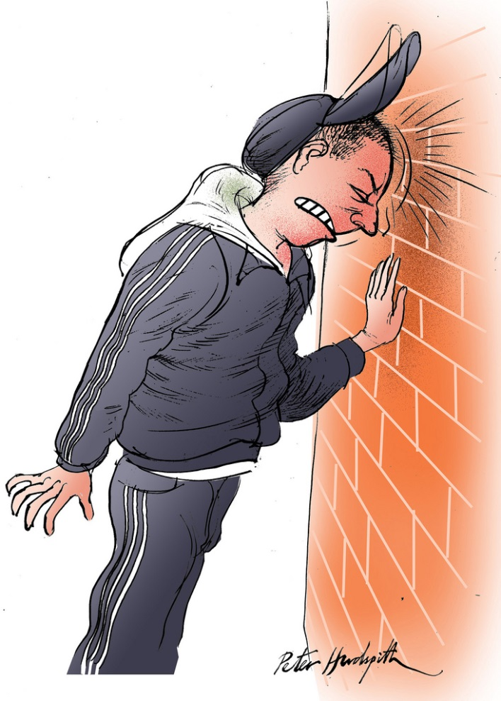
Stages of recovery
Withdrawal
  Lasts from 2 days – 2 weeks
Early Abstinence/Honeymoon
  Person starts to feel better
  Lasts from 2-6 weeks
Protracted Abstinence or “The Wall”
  6 weeks – 3 months into recovery
  Due to a lack of dopamine function
  Looks like depression – tearful, tired, not sleeping
  CBT & physical exercise can help
Adjustment/ Resolution
Notes:
Withdrawal
lasts from 2 days to 2 weeks
Early Abstinence/ Honeymoon
lasts from 2 weeks to 6 weeks
clients start to feel better
The Wall
6 weeks – 3 months in stimulant recovery
the absence of dopamine – brain not working right
treatment provides knowledge and encouragement that you can get through this – clients need to be taught about the wall so they don’t get over confident
go back to doing more basic stuff – scheduling
looks like depression – tearful, tired during the day, unable to sleep at night
physical exercise can help reduce the impact of the wall
often misdiagnosed as depression

Slide 51
Roadmap for Recovery
Early rehabilitation needs to be very behaviorally oriented
  structured time
  mutual support (e.g., Crystal Meth Anonymous)
  participate in new activities.
Exercise and physical activity are beneficial:
  managing withdrawal symptoms
  dealing with depression & anhedonia
Antidepressants may not be effective in treating meth-induced depression.
Avoid external triggers
Pharmacological advances - ?

Slide 52

Treatment and Recovery
Executive function, memory and regulation impaired….
  More frequent but shorter sessions
  Reminders
  Memory aids
  Assertive follow-up
  Written instructions
Notes:
Treatment is acute, Recovery looks at chronicity of the disease
Stimulants, including crystal meth, alter brain function in ways that impact treatment.

Slide 53

Maintain Hope
People DO recover from methamphetamine addiction

Slide 54
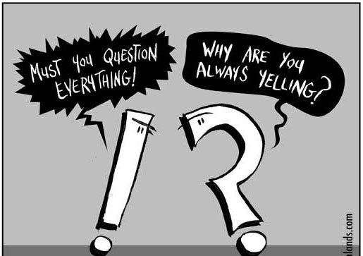
Questions?

Slide 55
References
Addictions Foundation of Manitoba (2013). Beyond the Basics: Methamphetamine. Retrieved from http://afm.mb.ca//wpcontent/uploads/woocommerce_uploads/2013/03/MethamphetamineBTB.pdf
Australian General Practice Network (2007). Management of patients with psychostimulant use problems – guidelines for general practitioners. Canberra: Australia. Australia Government Department of Health and Aging
CAMH (2016). Methamphetamine straight talk. Toronto, ON: Centre for Addiction and Mental Health
CAMH (2012). Methamphetamine, do you know…Toronto: ON: Centre for Addiction and Mental Health
Jenner, L. & Lee, N. (2008). Responding to challenging situations related to the use of psychostimulants: a practical guide for frontline workers. Australian Government Department of Health and Ageing, Canberra.
Jenner, L. & Lee, N. (2008). Treatment approaches for users of methamphetamine: a practical guide for frontline workers. Australian Government Department of Health and Ageing, Canberra.
Loke KS. (2014). Guidelines for the acute assessment & management of amphetamine-type stimulant intoxication & toxicity. Health Australia, St. Vincent’s Hospital. Retrieved from: http://www.australiandrugsconference.org.au/wp-content/uploads/Dr-Kah-Seong-Loke-Frontline-Management-Acute-Intoxication.pdf \
National Centre for Education and Training on Addiction (NCETA) (2015). Methamphetamine: Effects and Responses. Retrieved from http://nceta.flinders.edu.au/files/9014/3339/5938/EN597.pdf
Paulus, M. (2018). Methamphetamine use disorder: epidemiology, clinical manifestations, course, assessment, and diagnosis. In A.J. Saxon & R. Hermann (Ed.), UpToDate. Available from http://www.uptodateonline.com

